Slide 1
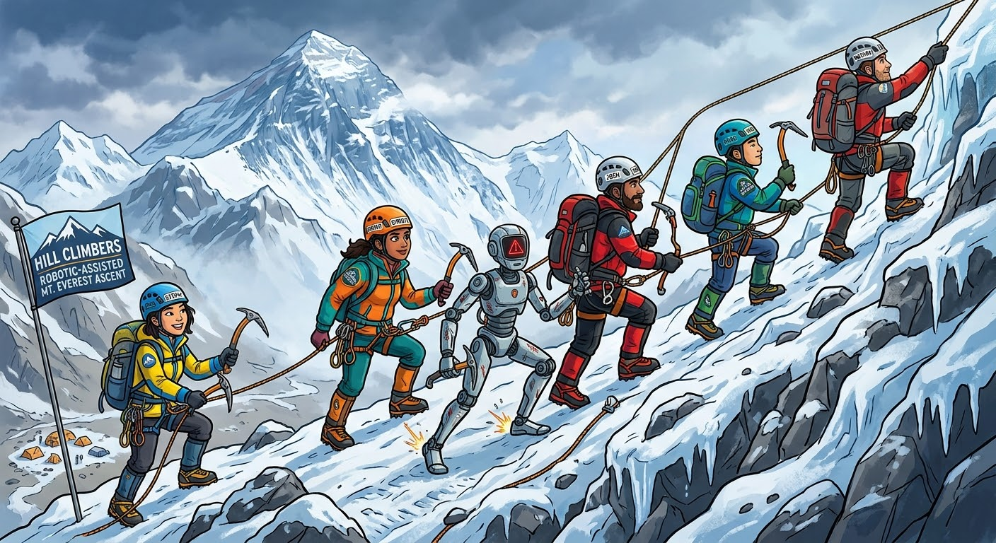
Everest Robot
Fault-aware attachment autonomy for extreme environment climbing
Himalaya Robotics Hack · 2026-08-30
We are the {Hill Climbers}

Slide 2
The {Problem}
Clipping a safety clip high up is easy for a rested person who is climbing,
but dangerous for anyone tired, gloved or operating remotely.
For a robot, it is even harder because :
Poor Sight : Cameras get blocked or blurred.
Drift : The robot cannot hold completely still
Blind Touch : It has to feel its way into the clip.
No Mistakes : A wrong guess means failing.

Slide 3
The {Solution} :
Action Chunking Transformer (ACT)
In ACT (“Action Chunking Transformer”), we physically move the robot arm through the task over and over, recording camera images + joint positions the whole time.
ACT then learns to predict -
“given what I currently know, and see where my arm is, what is the next little burst of motion that I could predict?”
We chose ACT because it is
Fast Training: Trains in a few hours on a single GPU + less jittery with smoothening
Lightweight: Only ~80M parameters, making it efficient and easy to work with
Data Efficient: Often achieves high success rates with just 50 demonstrations
Source : https://huggingface.co/docs/lerobot/en/act + https://github.com/makermods-robotics

Slide 4
The FSM States :
INITIAL
preflight + observe
SEARCH_RL
learned search
SEARCH_CV
calibrated follow
CLIP_RL
grasp + clip
SUCCESS verified only
FAILED budget exhausted

Slide 5
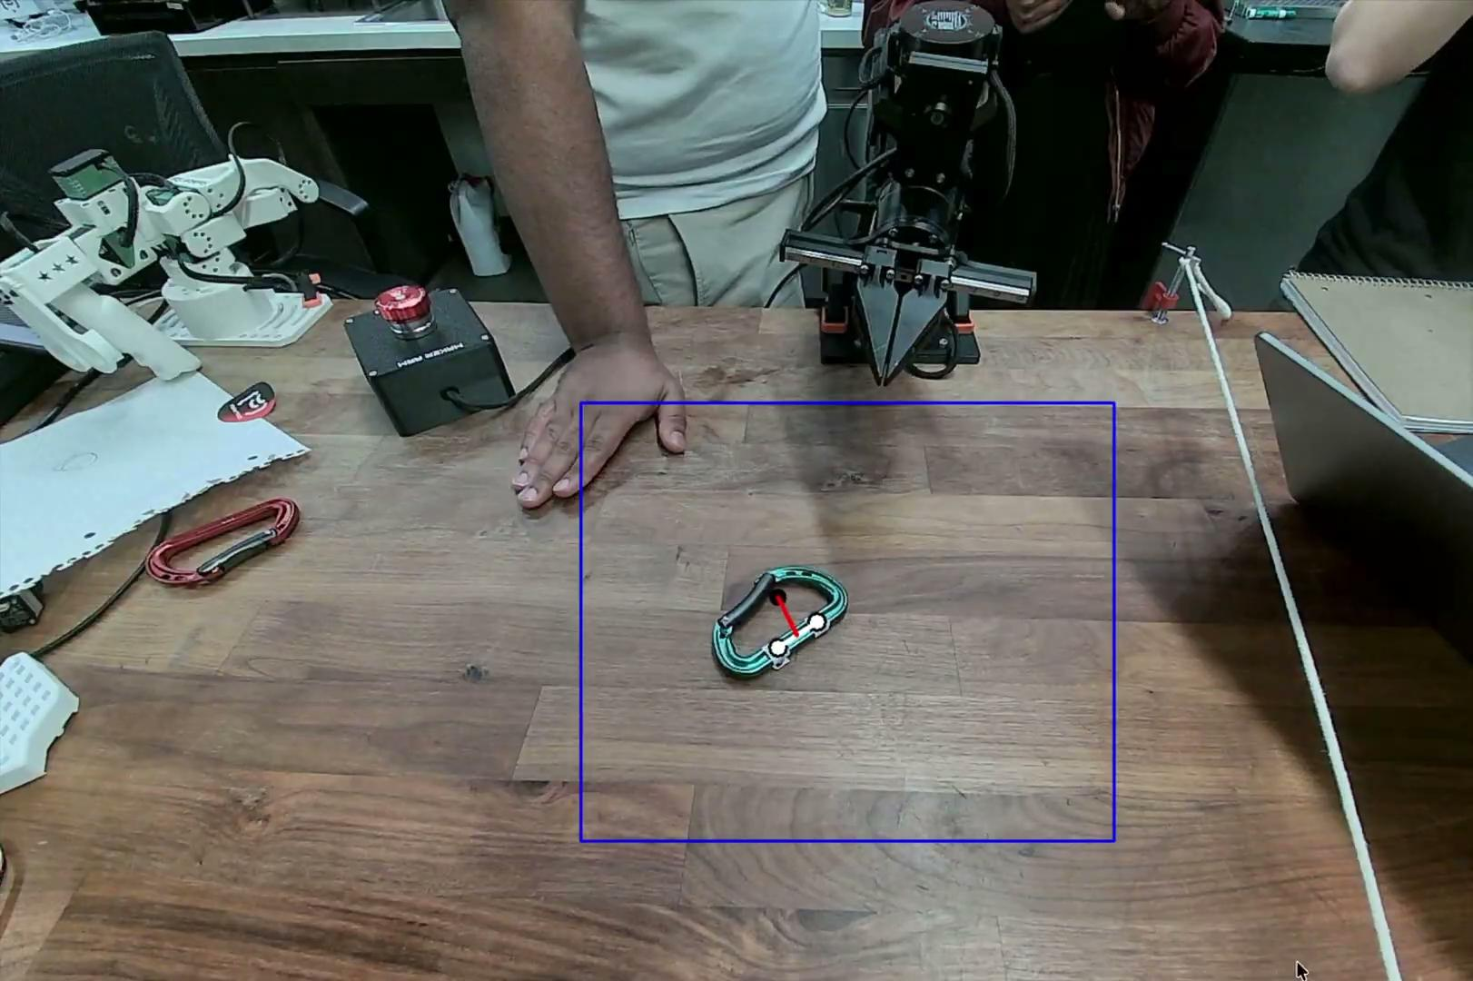
Where is the carabiner?
2 white points
Position
1 black point
Orientation

Slide 6


Slide 7

Questions?

